Slide 1
support material
Powerpoint by Helen Yip

Slide 2

Day 1
Activity Objective:
Move the red dot onto the person’s nose.
Skills learned for research project:
Understanding the basics of R Studio
Moving objects using Cartesian coordinates

Slide 3
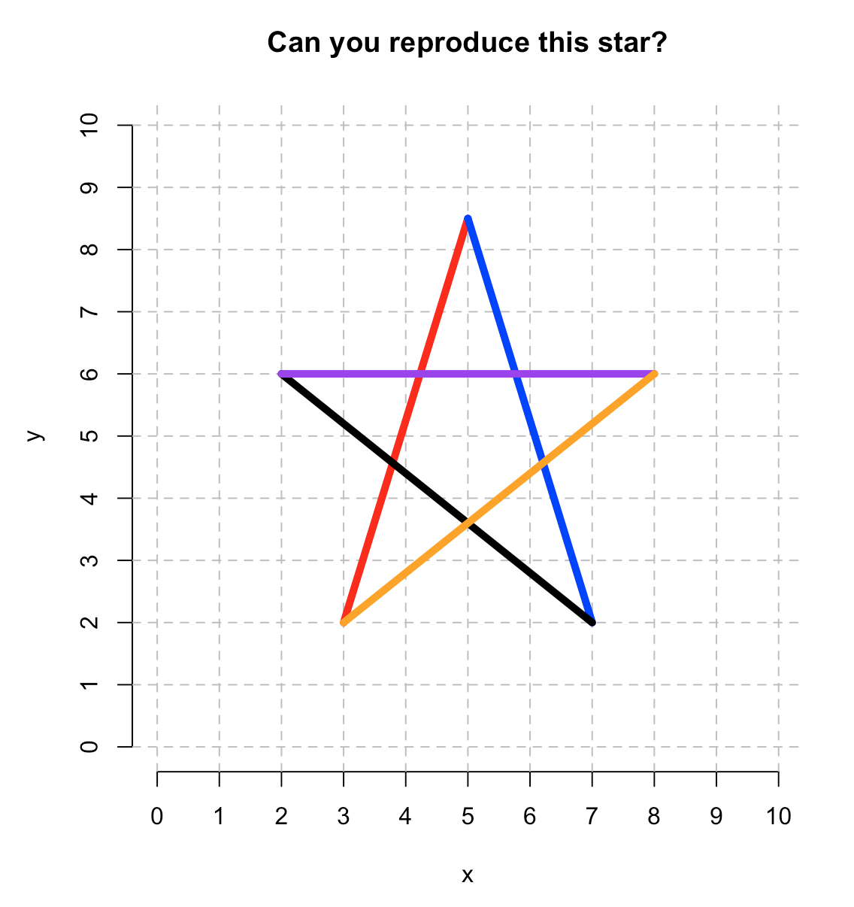
Day 2
Activity Objective:
Create different colored lines across in a Cartesian grid to create a star
Skills learned for research project:
Creating lines
Changing colors of objects

Slide 4

Day 3
Activity Objective:
Create an animation of a man running across a grid
Skills learned for research project:
Learning to work with semi-automated code to speed up a repetitive process

Slide 5
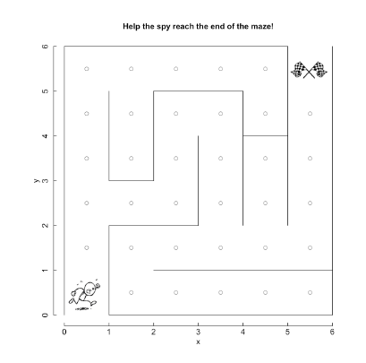
Day 4
Activity Objective:
Become more proficient at moving an object through a Cartesian grid
Have fun!
Skills learned for research project:
Develop proficiency with Cartesian coordinates

Slide 6
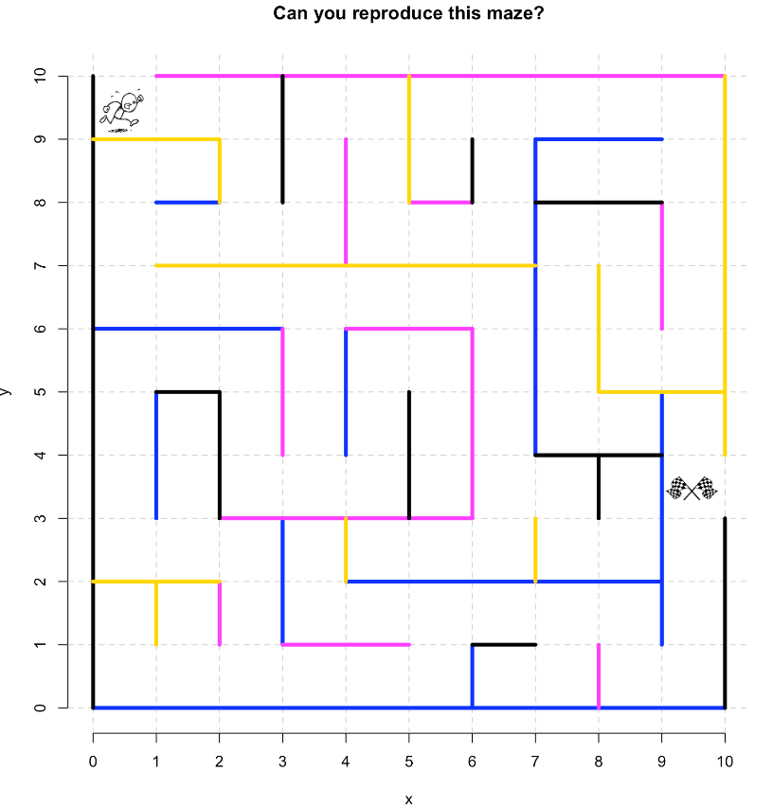
Day 5
Activity Objective:
Create lines that differ in color and orientation
Skills learned for research project:
Better understand how to read and manipulate code
Practice being precise when inputting values

Slide 7
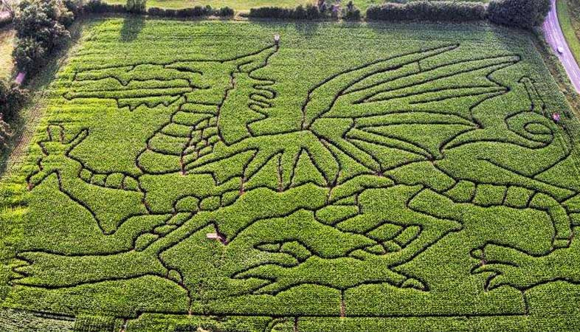
Day 6
Activity Objective:
Create your own maze by applying the skills previously learned
Skills learned for research project:
Combine multiple skills gained over a variety of activities

Slide 8
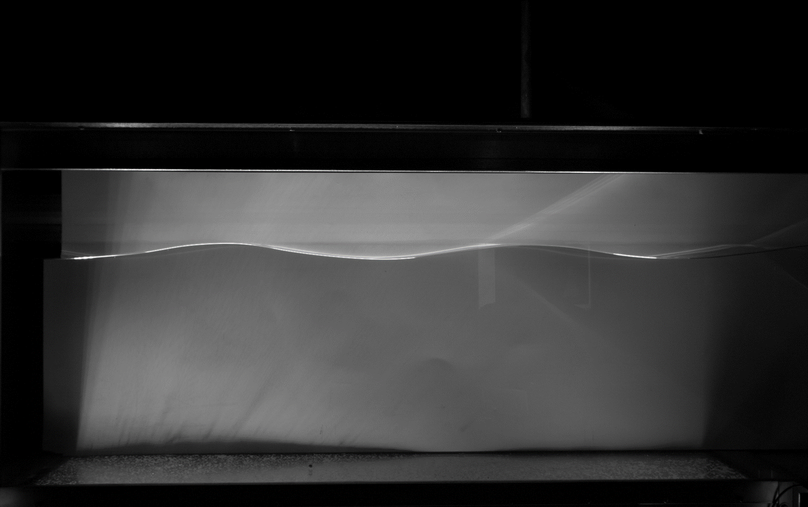
Coding Activity 7
Activity Objective:
Align rulers so that they label different parts of a wave
Skills learned for research project:
Understand how to obtain wave measurements, including water depth, wavelength and amplitude
Crest 1
Crest 2
Top of crests
Water level
Bottom of tank

Slide 9
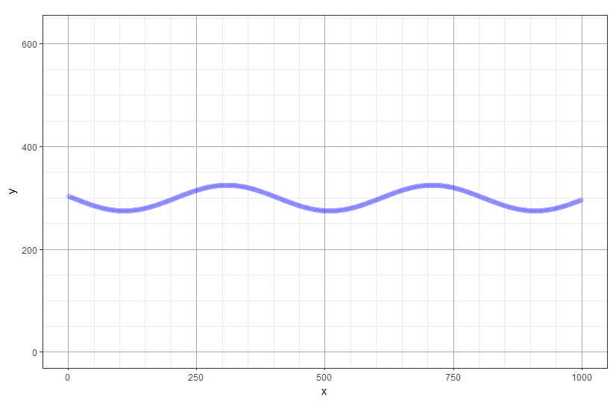
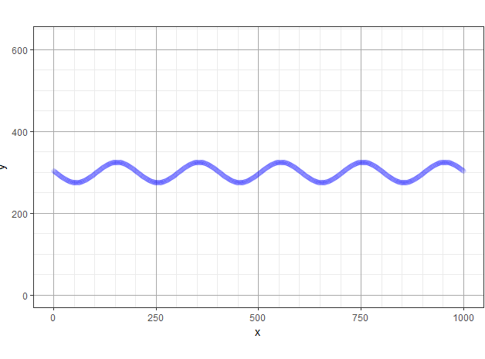
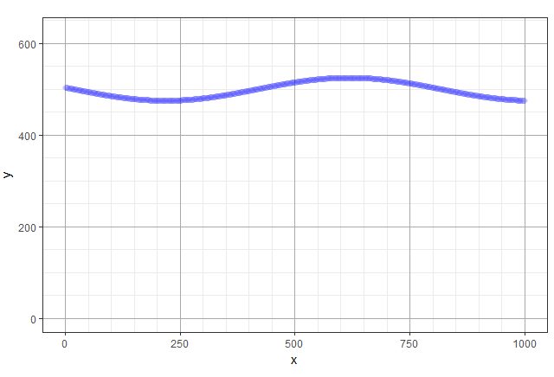
Coding activity 8
Activity Objectives:
Modify wave parameters to see their effects
Use R to perform calculations and generate plots
Skills learned for research project:
Develop intuition for a wave equation using R

Slide 10
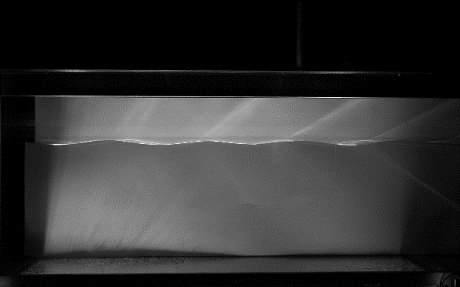
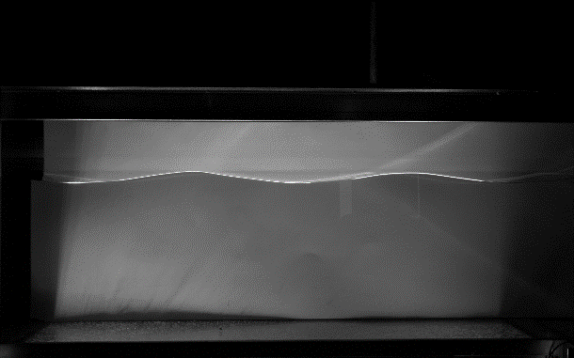

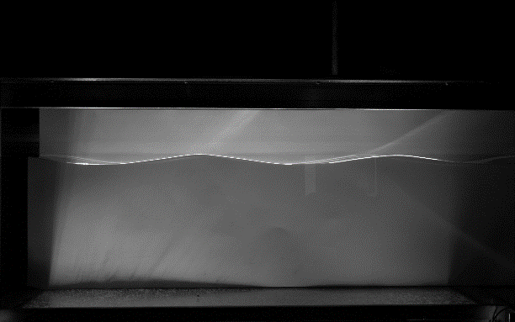

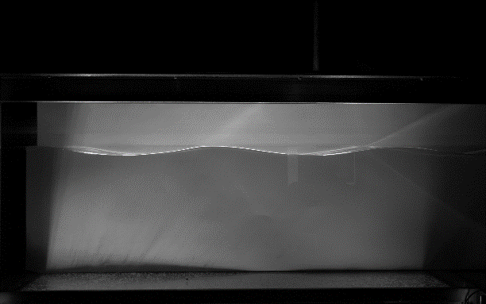

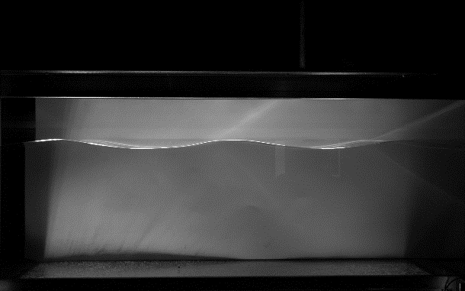
Coding activity 9
Wave 1
Wave 2
Frame 1
Frame 2
Frame 2
Frame 3
Frame 3
Frame 4
Frame 4
Frame 5

Slide 11
Activity 10
What type of wave interacts with the bottom?
Shallow Water Wave
Deep Water Wave
Note: in the videos, one type of wave moved dirt at the bottom of the tank, the other did not interact with the dirt

